Slide 1
ARTIFICIAL INTELLIGENCE
MADE BY- Ujjawal Tiwari
Roll No: 2501730064
Course: BTech-CSE-Ai/Ml

Slide 2


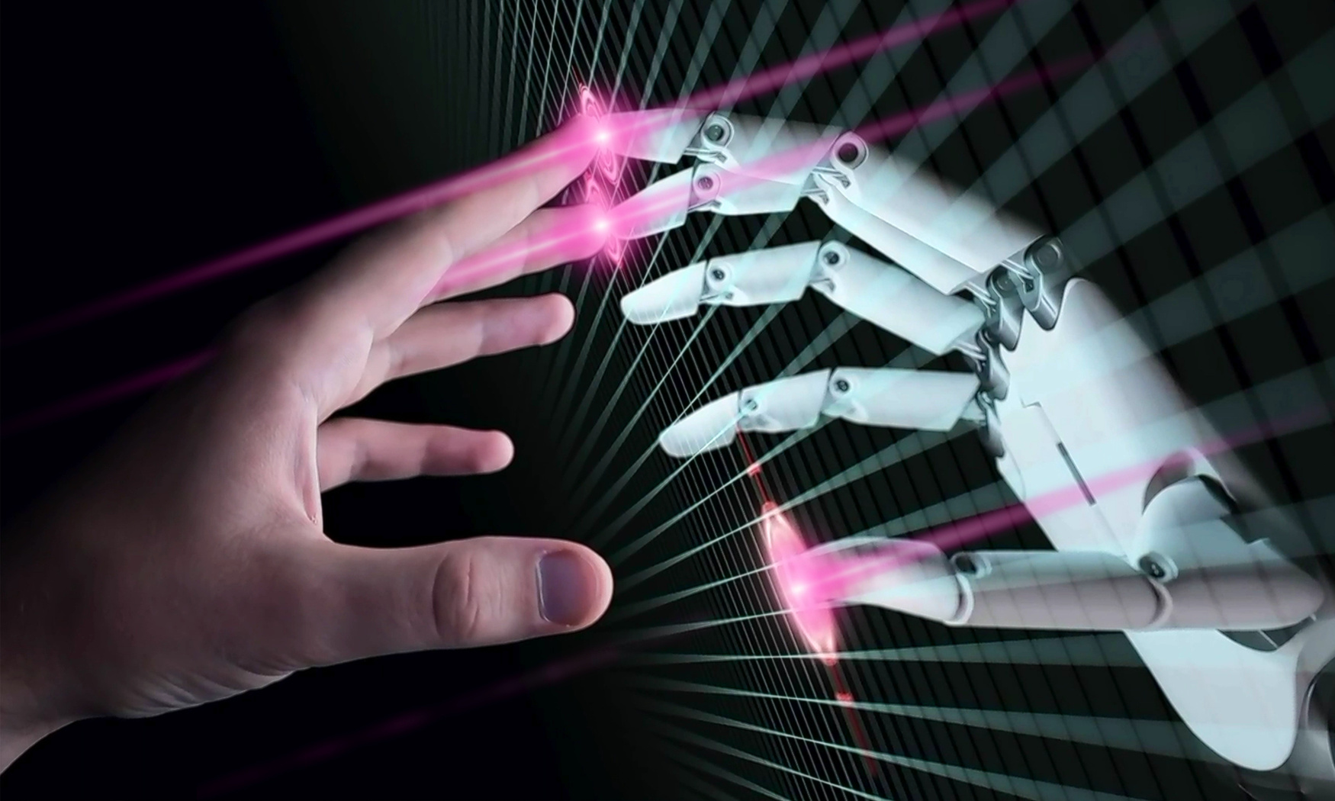

ABOUT AI
The ability of machines to perform tasks that typically require human intelligence, such as learning, reasoning, and problem-solving.
It works by enabling computers to perceive their environment, process data, and act to achieve goals, and it is a transformational technology used in many applications, from voice assistants to medical diagnoses.

Slide 3
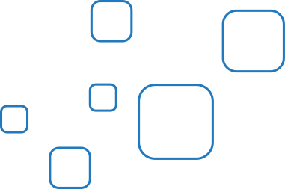



KEY TECHNOLOGIES
MACHINE LEARNING (ML)
DEEP LEARNING (DL)
NATURAL LANGUAGE PROCESSING (NLP)
  Uses neural networks like CNNs, RNNs, LSTMs, and Transformers. Used in imaging, speech, and autonomous systems.
Helps machines understand human language. Used in chatbots, translation, and sentiment analysis
  ML systems learn from data without being explicitly programmed. Types include supervised, unsupervised, and reinforcement learning

Slide 4
KEY TECHNOLOGIES
COMPUTER VISION
ROBOTICS & AUTONOMOUS SYSTEMS
AI TOOLS & PLATFORMS
  Interprets visual data such as images & videos. Used in face recognition, medical imaging, and surveillance
  Combines AI with sensors and controllers. Used in manufacturing, logistics, and healthcare
TensorFlow, PyTorch, Scikit learn, AWS Sagemaker, Google Vertex AI

Slide 5


USE OF AI
INDIA
INDIAN RAILWAYS
APOLLO HOSPITALS
PREDICTIVE MAINTENANCE AI PREDICTS ENGINE FAILURES USING VIBRATION AND TEMPERATURE DATA.
PROHEALTH AI PREDICTS DISEASES EARLY AND CREATES PERSONALISED PLANS.

Slide 6
USE OF AI
INTERNATIONAL
TESLA AUTOPILOT
AMAZON LOGISTICS
AI OPTIMISES DELIVERY ROUTES, ROBOTS, AND DEMAND FORECASTING.
EVEN THE SUGGESTION ARE MAINTAINED BY AI
USES NEURAL NETWORKS AND COMPUTER VISION FOR AUTONOMOUS DRIVING

Slide 7



CAREER OPPORTUNITIES
HIGH-DEMAND ROLES
INDUSTRIES HIRING AI PROFESSIONALS
AI ENGINEER
MACHINE LEARNING ENGINEER
DATA SCIENTIST
COMPUTER VISION ENGINEER
NLP ENGINEER
SKILLS REQUIRED
HEALTHCARE
FINANCE, AUTOMOTIVE
E-COMMERCE, DEFENCE
AGRICULTURE, EDUCATION
CYBERSECURITY
PYTHON (NUMPY, PANDAS, SCIKIT-LEARN)
NEURAL NETWORKS, DEEP LEARNING
DATA ANALYSIS & VISUALIZATION
MATHEMATICS: LINEAR ALGEBRA, STATISTICS
CLOUD AI SERVICES
MODEL DEPLOYMENT (DOCKER, FASTAPI)

Slide 8


THANK YOU

